Slide 1
PGB Session
1 August 2024
Ms. Katherine Escobar
NIEMOpen Project Governing Board Chair

Slide 2
Needs Updating
Slide 8 - add BJS & NIJ as PGB
Slide 9 – update maintainers
Slide 10 – update agenda
Slide 16 – CY 2024 Q2 Financials, Mayo
Slide 17 – BJS, NIJ as sponsors
Slide 21 - Summit Update – Jane
Slide 28 - API 2.0 Progress – Shunda
Slide 34 – iepd repo link, NIEN excellence awards location of materials - Shunda
Slide 35 – MEP repo link - Aubrey

Slide 3
Call to order
Called to order the regular virtual meeting of the NIEMOpen Project Governing Board at 2 PM, 1 August 2024.
Notes:
Chair: This meeting is being recorded for the record and a link will be provided in the minutes.

Slide 4
Venue
Microsoft Teams 1 August 2024 PGB Meeting
PGB Meeting
1 August 2024
Virtual Meeting 2-4 PM EST
Virtual: MS TEAMS
Microsoft Teams
Join the meeting now
Meeting ID: 993 848 600 07
Passcode: TP2EnR
Dial-in by phone
+1 410-874-6749,,622463276# United States, Odenton
Find a local number
Phone conference ID: 622 463 276#
Current and post meeting location of 1 Aug PGB Meeting documents:

Slide 5
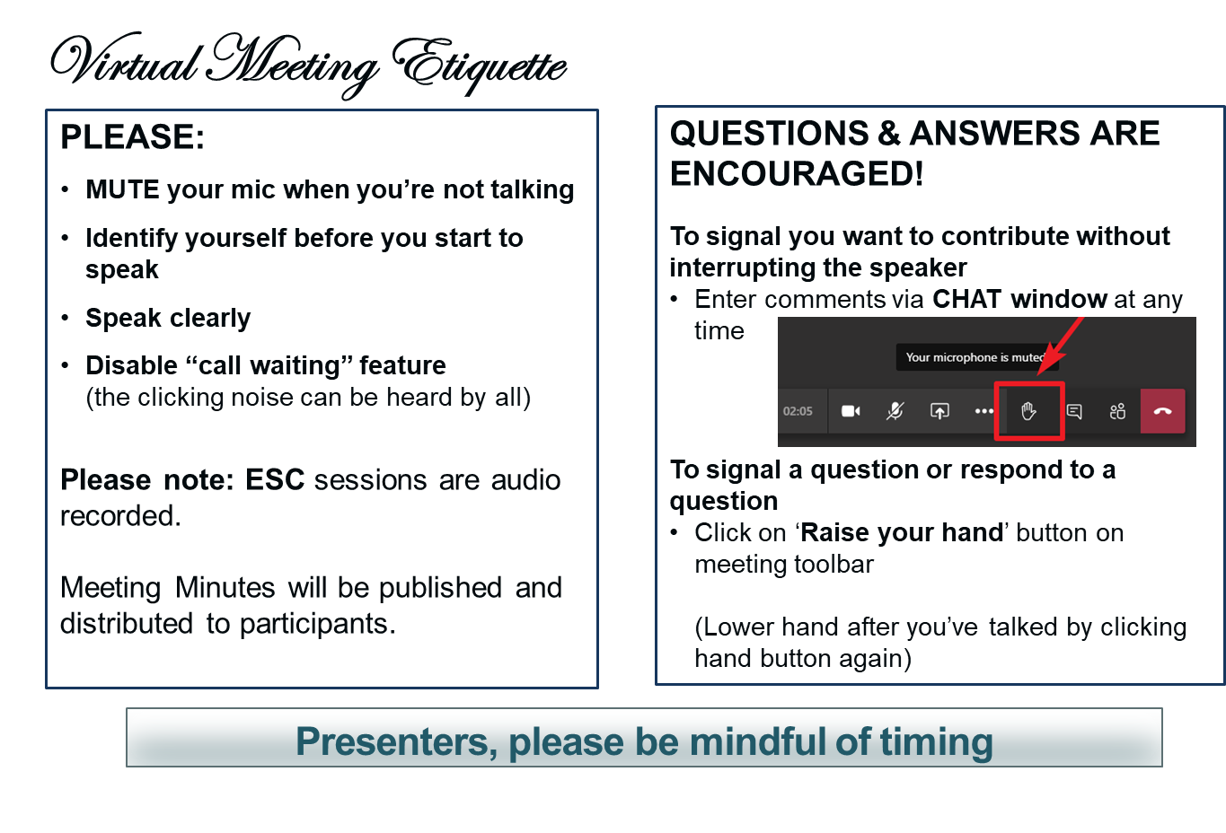
Making the most of our session
Notes:
VOTING: The usual method of voting is viva voce (by voice). To accommodate the virtual setting the chair may ask members to “Raise your hand” to signal aye or no.

Slide 6
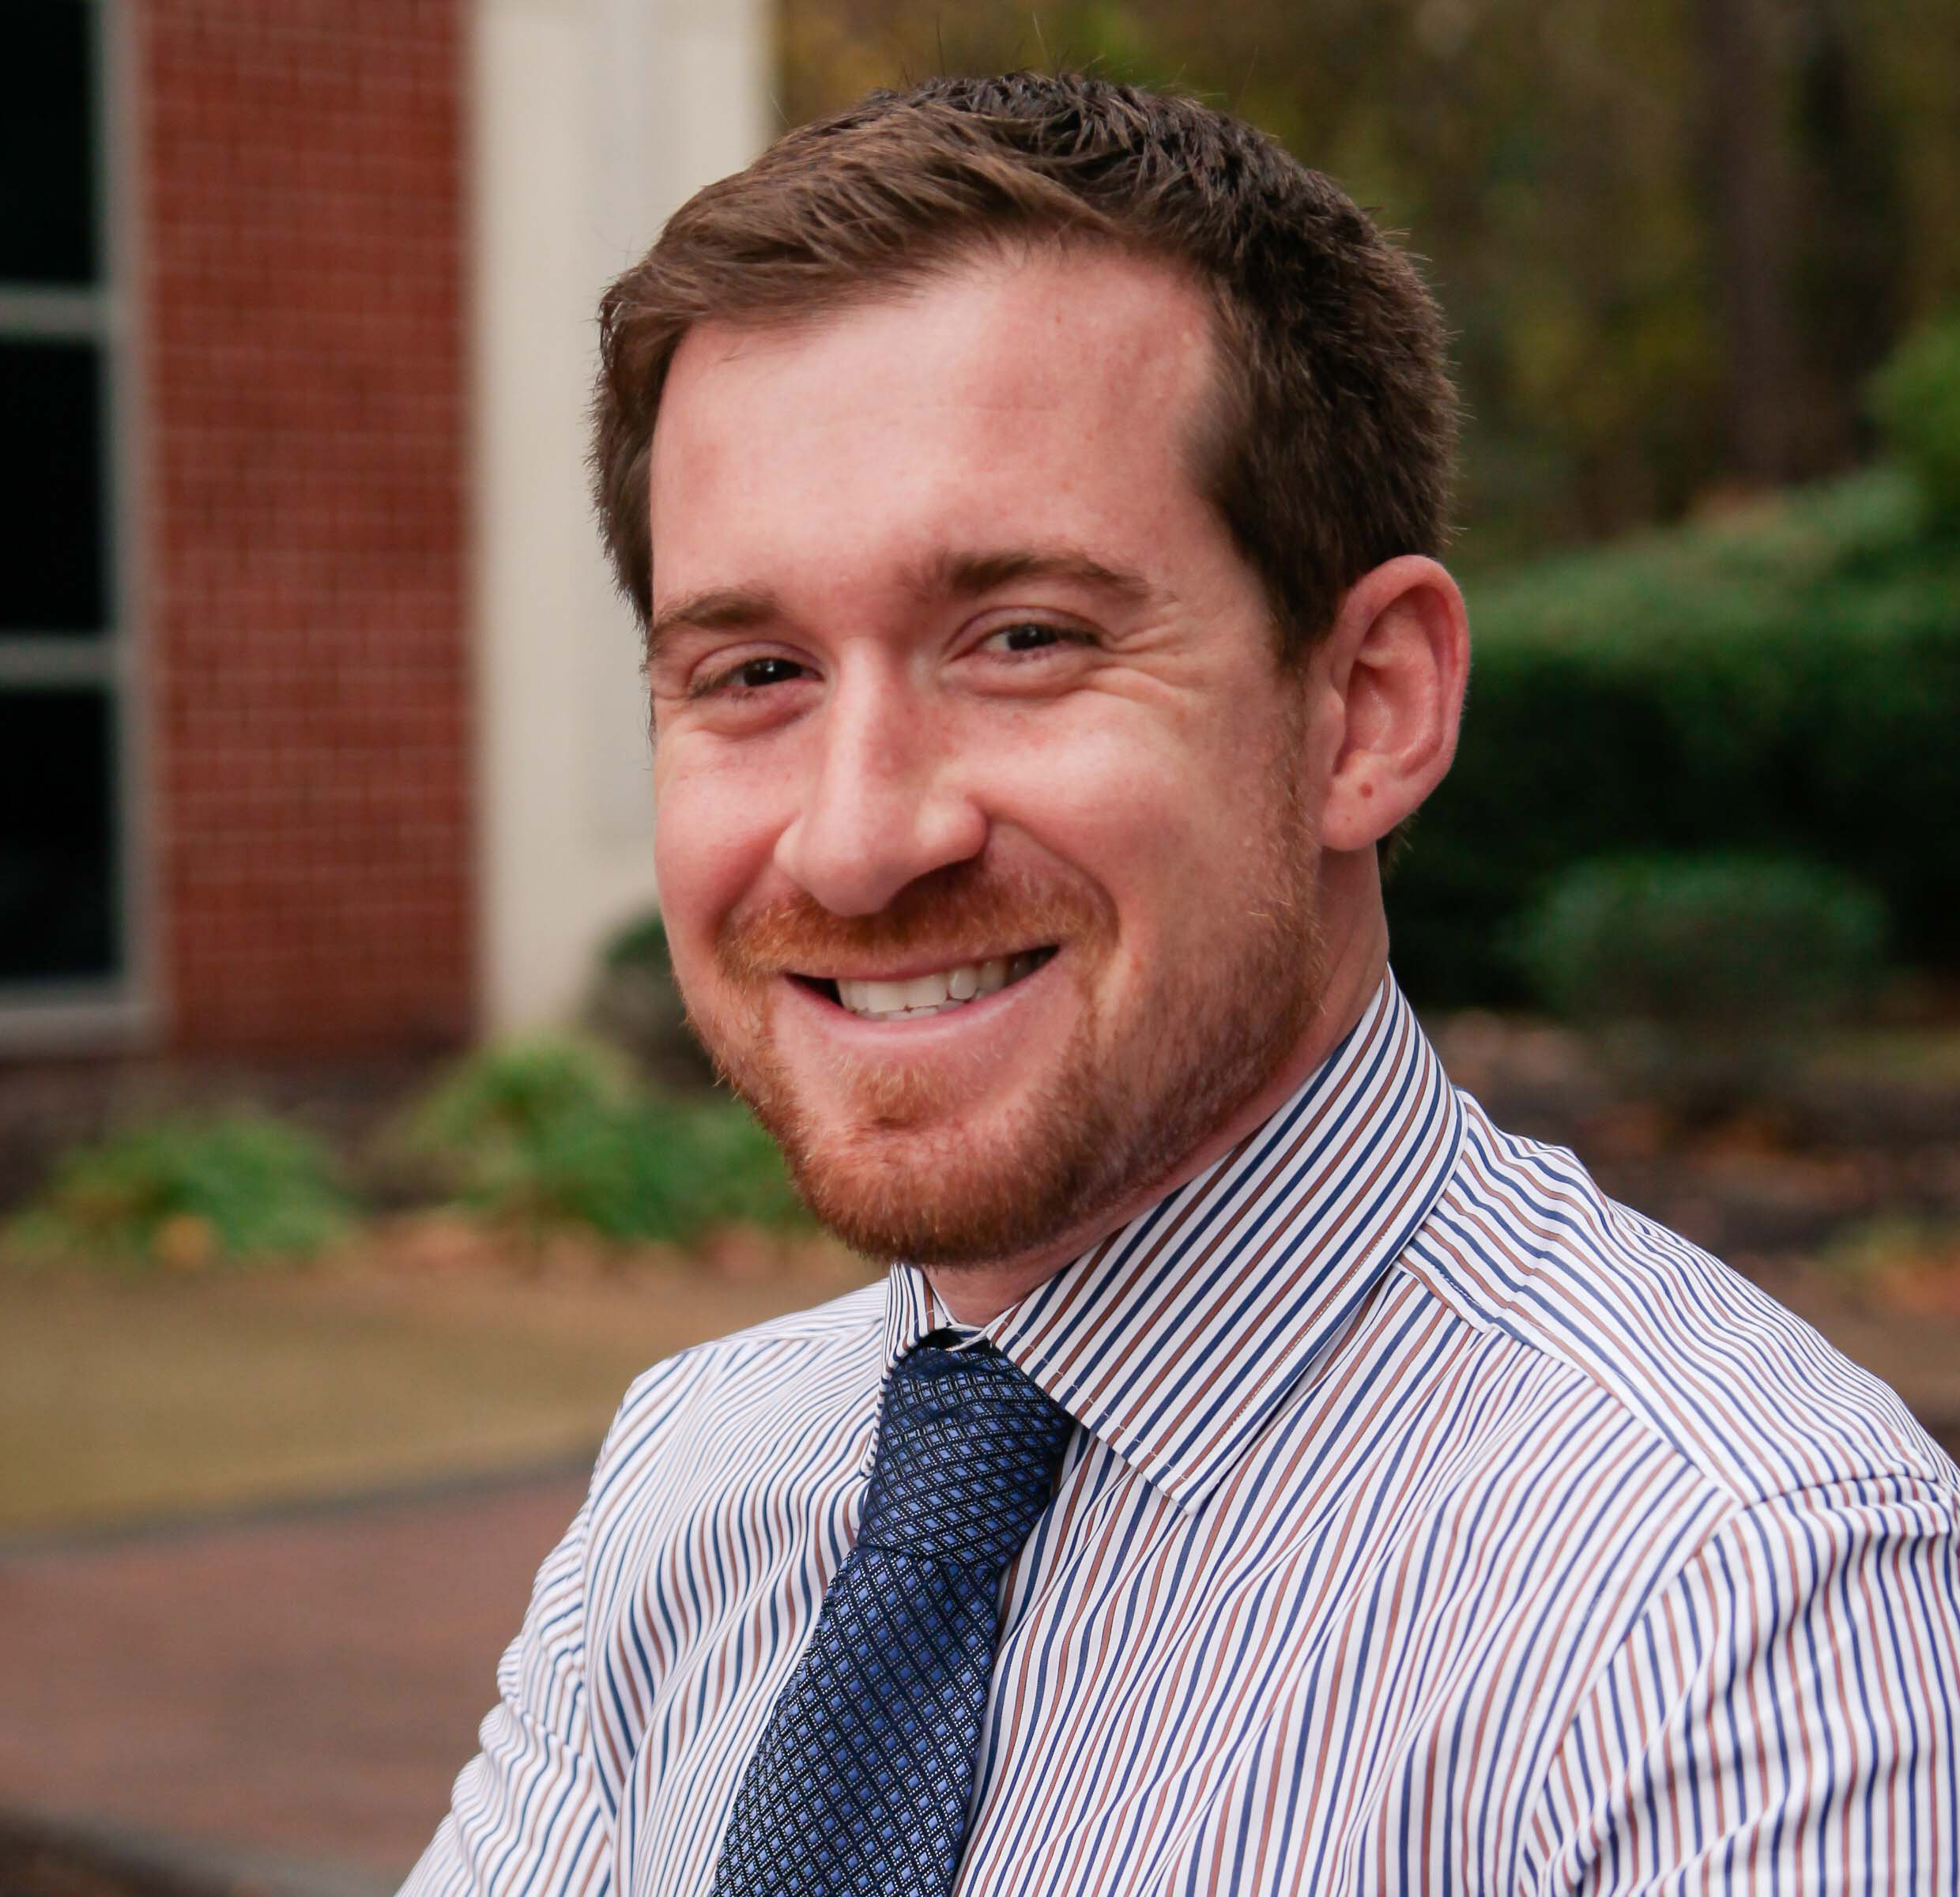
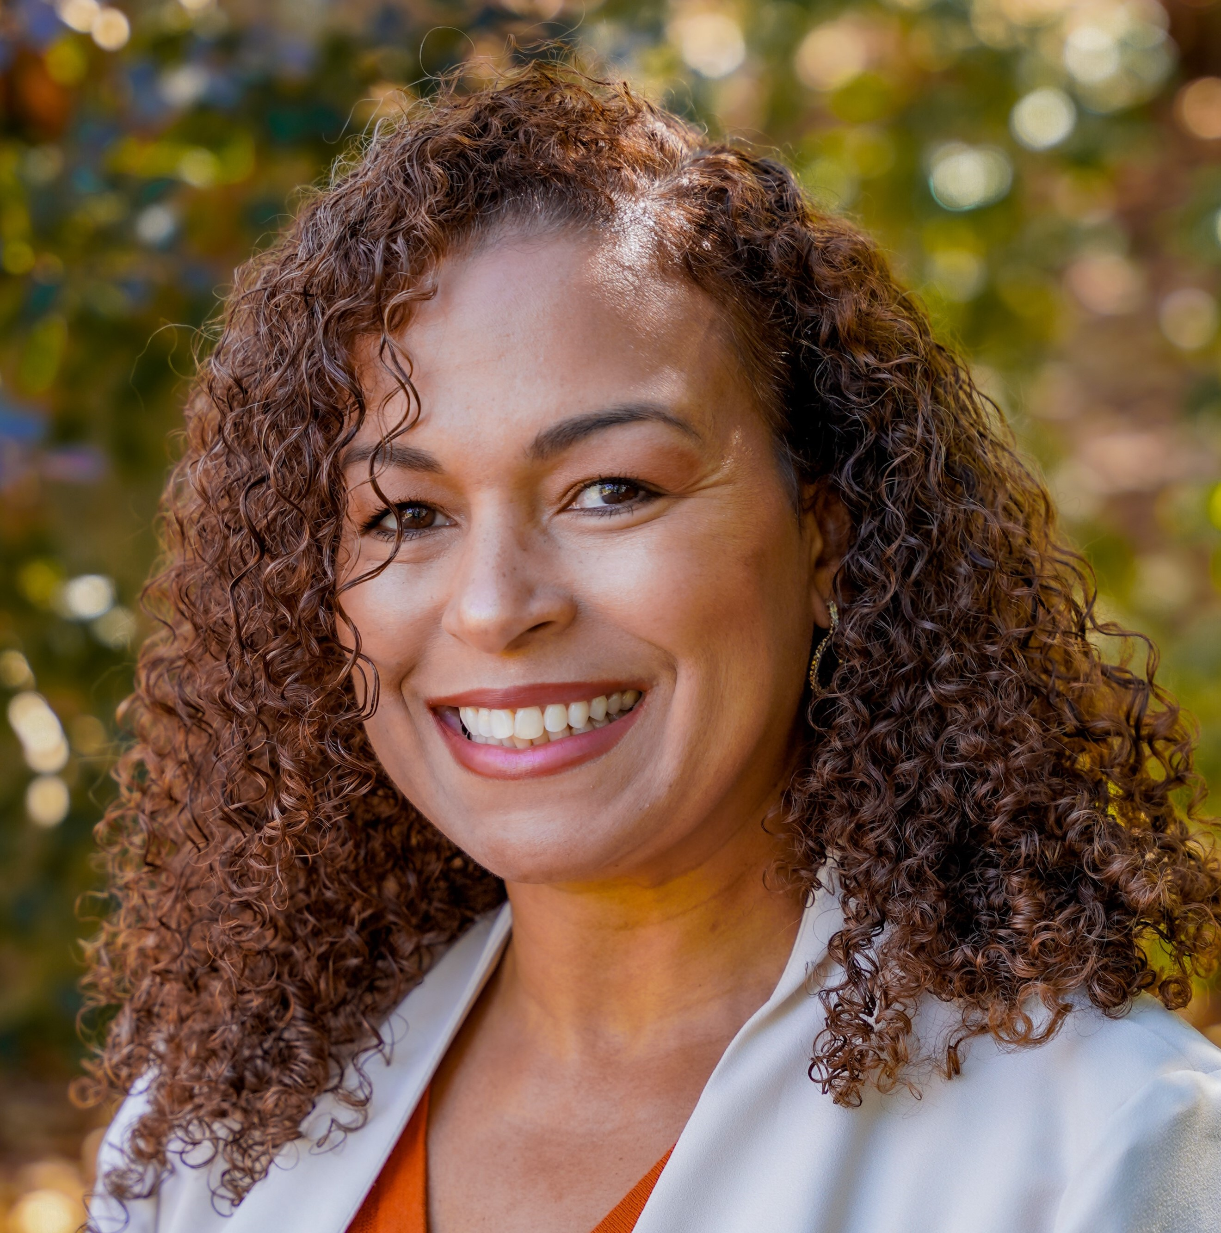
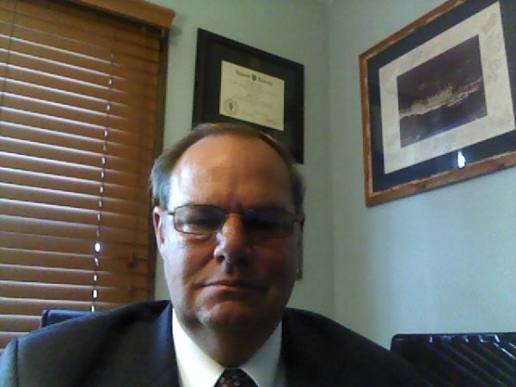
Note taker
The PGB Executive Session is being recorded on MS TEAMS. A link to the recording will be provided and meeting minutes will be posted on the NIEMOpen Git Repo once approved: https://github.com/niemopen/oasis-open-project/tree/main/pgb-meeting-minutes
Meeting support, note takers:
Aubrey Beach
aubrey.l.beach.ctr@mail.mil
Shunda Louis
shunda.r.louis.ctr@mail.mil
Stephen Sullivan
stephen.m.sullivan14.ctr@mail.mil

Slide 7
Roll call
PGB Voting Members:
Department of Defense Joint Staff J6 (DoD JS J6)
Department of Homeland Security Science & Technology (DHS S&T)
Equivant
Georgia Tech Research Institute (GTRI)
Integrated Justice Information Systems Institute (IJIS)
Commonwealth of Virginia, Office of Data Governance and Analytics
Criminal justice Information Systems Division (CJISD), Federal Bureau of Investigation
PGB Expert Voting Members
NBAC TSC
NTAC TSC
NMO TSC
PGB Expert NON-Voting Members
Notes:
Chair: Will the secretary call the role
PGB Voting Members:
Department of Defense Joint Staff J6 (DoD JS J6) – Ms. Katherine Escobar
Department of Homeland Security Science & Technology (DHS S&T) – Ms. Christina Bapst-Stump
Equivant – Mr. Gary Egner
Georgia Tech Research Institute (GTRI) – Mr. John Wandelt
Integrated Justice Information Systems Institute (IJIS) – Ms. Maria Cardiellos
Commonwealth of Virginia, Office of Data Governance and Analytics – Mr. Payton Lamb
Criminal Justice Information Services Division (CJISD), Federal Bureau of investigation, – April Mitchell
PGB Expert Voting Members
NBAC TSC – Mr. Kamran Atri
NTAC TSC – Mr. Jim Cabral (InfoTech)
NMO TSC – Ms. Beth Smalley (Joint Staff J6 DSD)
PGB Expert Non-Voting Members
NBAC TSC – Mr. Thomas Krul (National Defence Canada)
NTAC TSC – Dr. Scott Renner (MITRE)

Slide 8
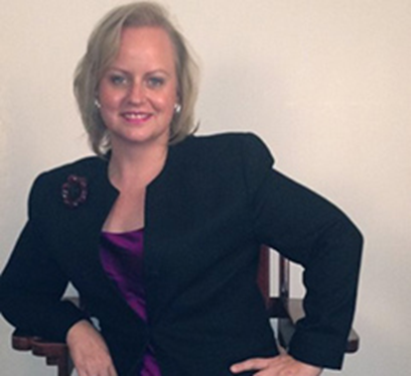
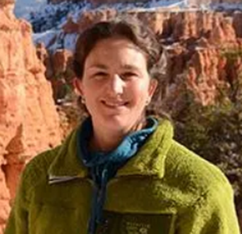
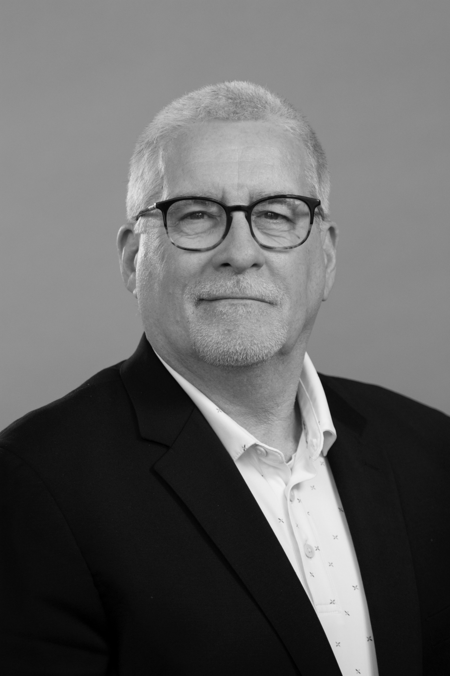
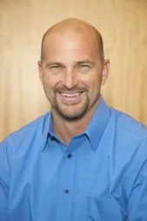
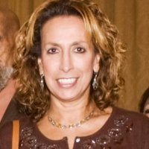
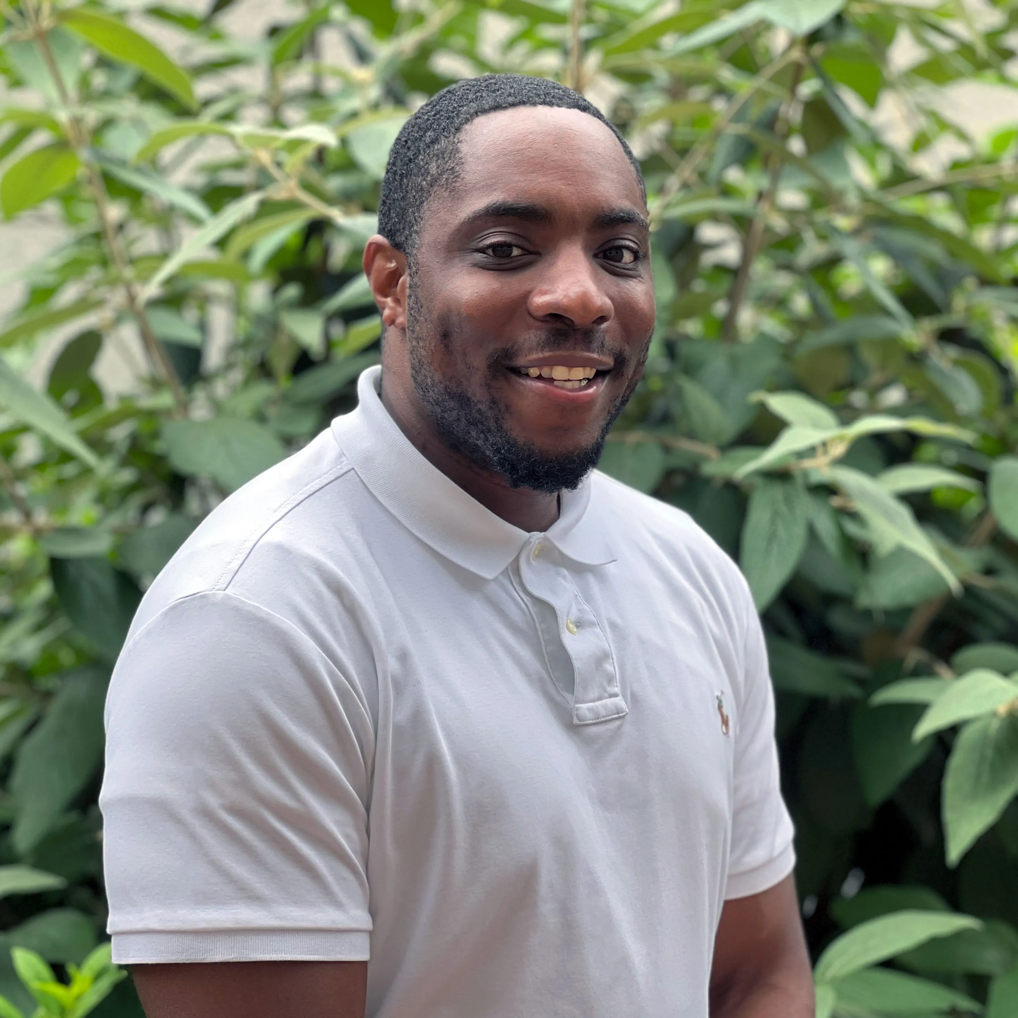
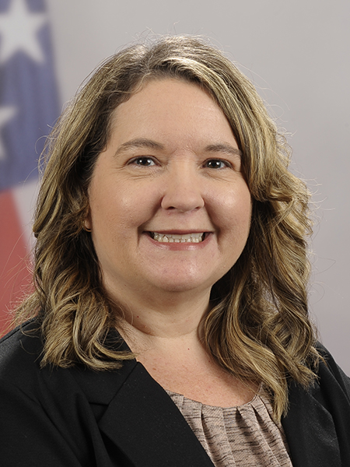
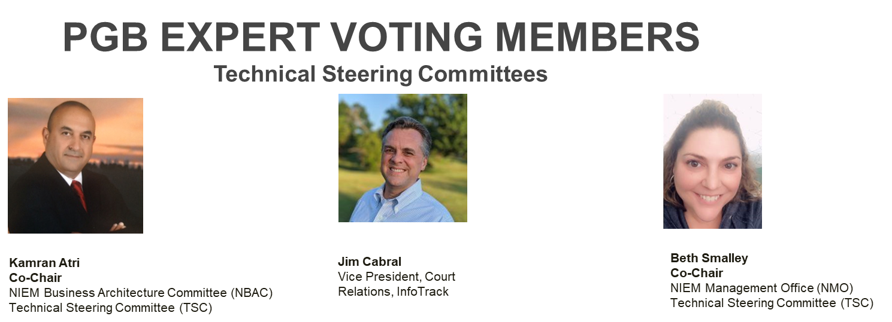

PGB APPOINTED VOTING MEMBERS
Ms. Katherine Escobar
PGB Chair
Deputy Division Chief, Data and Standards Division at Joint Staff J6 and NIEM Managing Director
Ms. Christina Bapst-Stump
Science and Technology Directorate, US Department of Homeland Security
Mr. Gary Egner
Director Business Development, Equivant
Mr. John Wandelt
Principal Research Scientist, Georgia Tech Research Institute
Ms. Maria Cardiellos
Executive Director
Integrated Justice Information Systems Institute
Mr. Payton Lamb
Data Engineer
Commonwealth of Virginia
Office of the secretary of Administration
Office of Data Governance and Analytics
Ms. April Mitchell
FBI It Specialist and Technical Lead of Data Standards in the Criminal Justice Information Services (CJIS) Division
Notes:
Open Project Rules - OASIS Open (oasis-open.org)
5.1 Overall guidance for the Project is provided by its Project Governing Board (or PGB). The PGB is composed of one voting member from each Project Sponsor who elects to appoint a PGB member, and (a) if the PGB has one or more Technical Steering Committees, one voting expert representative from each TSC, elected or appointed by that TSC, or (b) otherwise, the PGB may appoint at least one and no more than two voting expert representatives from its community of contributors. The PGB may create additional non-voting PGB member seats for expert representatives to be elected by the TSC or appointed by the PGB. The PGB membership of all such members of any type is conditioned on satisfaction of the CLA requirement of Section 5.2. Voting status on the PGB may be affected by the provisions of Section 5.7.

Slide 9
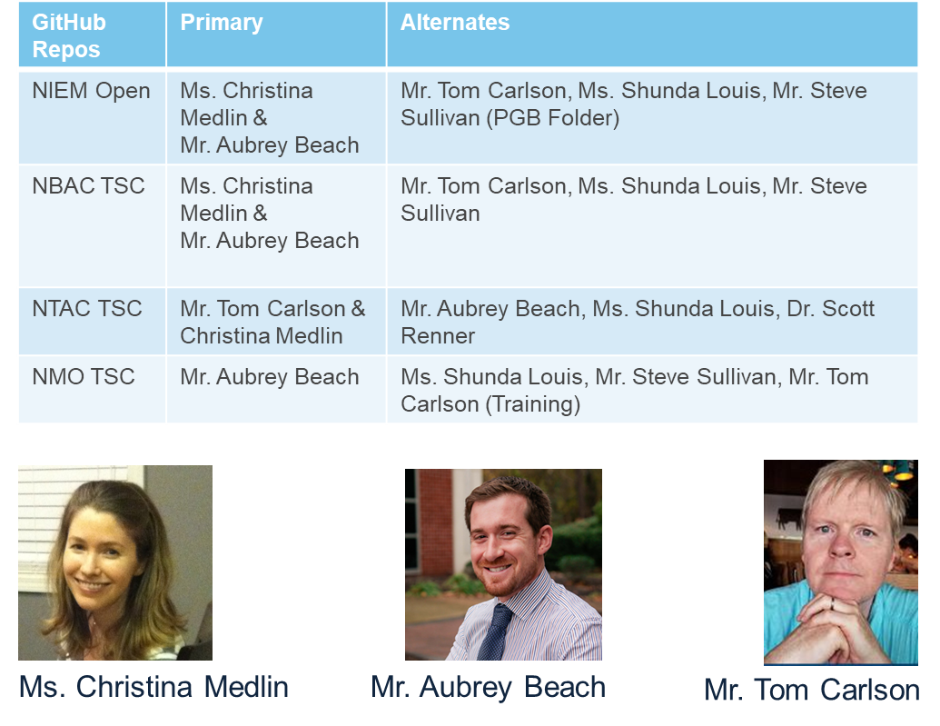
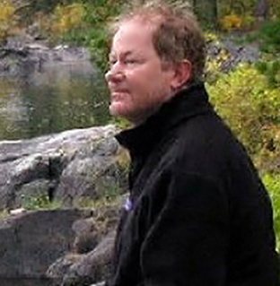
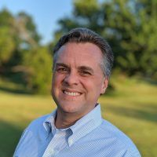
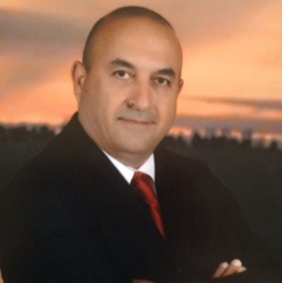
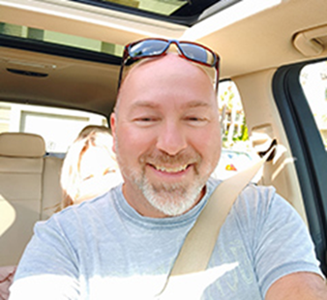

NMO, NBAC, & NTAC TSC Co-Chairs & OASIS Maintainers
TSC | Approved (TSC CHAIRS)
NMO TSC | Ms. Katherine Escobar & Ms. Beth Smalley
NBAC TSC | Mr. Kamran Atri & Mr. Thomas Krul
NTAC TSC | Dr. Scott Renner & Mr. Jim Cabral
NTAC TSC
NBAC TSC
NMO
TSC

Slide 10
Proposed 1 August 2024 PGB Agenda
Call to Order
Admin
TEAMS Link
Meeting Etiquette
Note Takers
Roll Call & Introductions
PGB Voting Members (Sponsors) & PGB Expert Voting Members (TSCs) & PGB Non-Voting Members (TSC Co-Chairs)
TSC Co-Chairs & NIEMOpen Maintainers
Approval of Agenda
Around-the-Horn – PGB Voting Members
Approval of Meeting Minutes from 11 April Jan 2024
OASIS Staff / NIEMOpen Administrator Comments
Q1 Financial Snapshot – Cathie Mayo (OASIS)
Sponsor Update – Carol Geyer
CY 2024 Planning
Reveal Update – Jane Harnad
5 Minute Break
Motions
2025 PGB Meeting Dates
Updates
NTAC Update
NDR6 – Jim Cabral
NBAC Update – Kamran Atri
NMO Update
PS02 Update – Christina Medlin
API 2.0 Progress - Christina Medlin
MEP Tool DEMO – Aubrey Beach
LearnPress – Aubrey Beach
Communications & Outreach Sub-Committee
Next Meeting
Other Business/General Discussion
Action Items
Questions/Adjourn

Slide 11
Approval of Agenda
Chair: A Draft Agenda for the NIEMOpen 1 August 2024 Project Governing Board (PGB) Meeting was provided to PGB Voting Members as a readahead.
Chair: Are there any recommended changes to the agenda as distributed?
Chair: If there are no (further) changes, the agenda stands approved as distributed (corrected).
?
Approve
Approve as Corrected
Notes:
Chair asks PGB to approve 25 January 2024 PGB Meeting AGENDA.

Slide 12

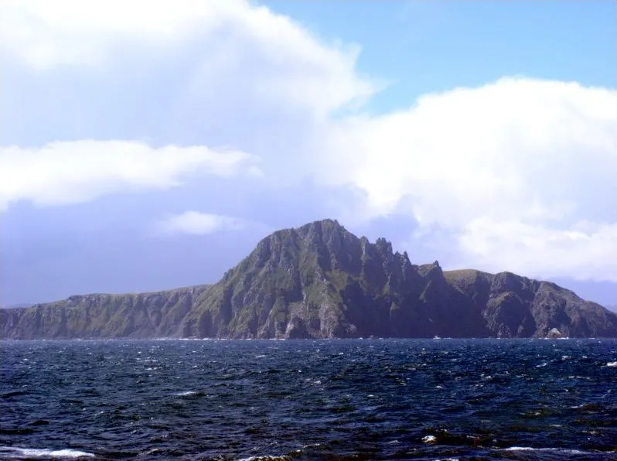
PGB MEMBERS: Around-the-horn
Notes:
The Go Around gives each person a brief turn to speak, without interruption. Everyone else listens. Also known as a Round Robin, Structured Go Around, or as going “Around the Horn”, this foundational meeting tool ensures that everyone can contribute their thoughts and comments.
The pictures on the slide is a metaphor for “Around the Horn”. It depicts the fictional ship, “the Black Pearl” transiting Cape Horn, the horn of Southern Chile. Located off the southern tip of mainland South America, it was named Hoorn for the birthplace of the Dutch navigator Willem Corneliszoon Schouten, who rounded it in 1616.

Slide 13
Approval of 11 April 2024 PGB Minutes
Chair: A Draft of the NIEMOpen 26 October 2023 PGB meeting minutes was provided to the PGB Voting Members as a readahead: Please let me know now if you found any errors. https://github.com/niemopen/oasis-open-project/blob/main/pgb-meeting-minutes/2024/11-April-2024/(DRAFT)%20NIEMOpen%20PGB%20Meeting%20Minutes%2011%20April%202024%20v2%205-1-2024%20(1).docx
Chair: Are there any corrections to the minutes as distributed?
Chair: If there are no (further) corrections, the minutes stand approved as distributed (corrected).
?
Approve
Approve as Corrected
Notes:
Chair requests that 25 Jan PGB Meeting minutes be approved.

Slide 14
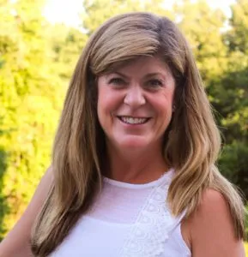
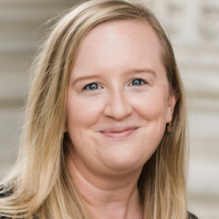
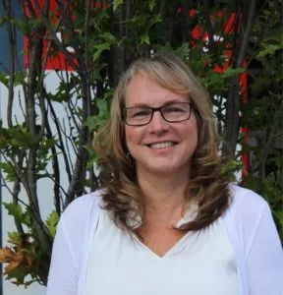
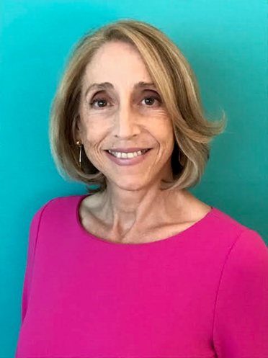

OASIS STAFF
Ms. Kelly Cullinane – OASIS Senior Director of Standards Development
Ms. Cathie Mayo – OASIS Chief Financial Officer
Ms. Jane Harnad – OASIS Manager of Events
Ms. Carol Geyer – OASIS Chief Development Officer
Ms. Holly Peterson – OASIS Business Development Manager
Notes:
Introduce OASIS Staff to new PGB Members

Slide 15

CY 2024 Q2 Financials
Ms. Cathie Mayo – OASIS Controller
Notes:
Chair introduces Cathie Mayo

Slide 16
CY 2024 Q2 Financials
Placeholder - Financials
Notes:
Chair introduces Cathie Mayo

